Slide 1
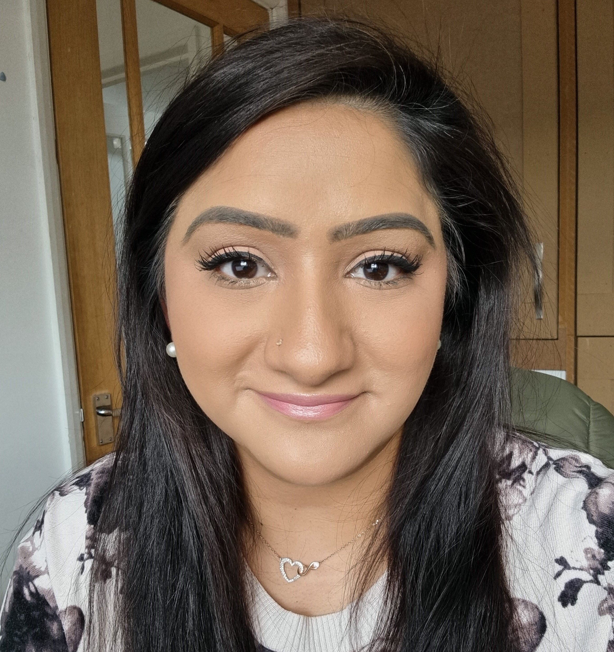
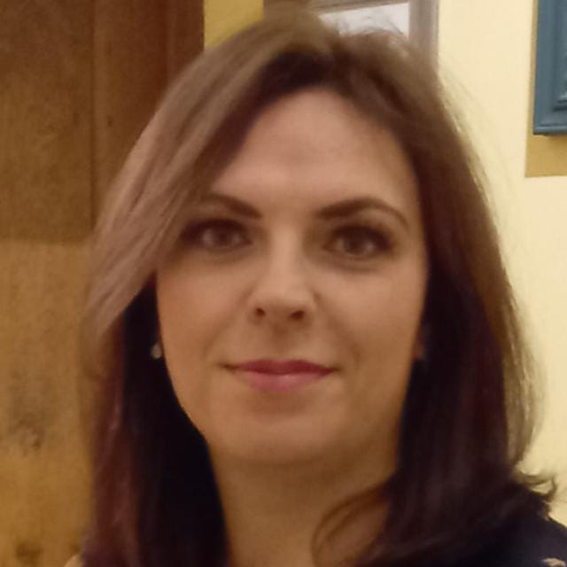
Kent and Medway Pathology- Career Clinics
Kent and Medway Pathology Network are hosting a live Q&A Webinar series to discuss Pathology Careers.
The sessions are open to all staff and will be delivered via MSTEAMS between 7-8pm on the 3rd Wednesday of the month.
The webinars will focus on the top most frequently asked Kent and Medway Pathology topic / career questions. The sessions will provide information and useful resources. So, if you are just starting out in your Pathology career, looking for new opportunities and future career aspirations or are involved in training and education – please come and join us!
Topics for future sessions are down to you – so submit your career questions to Manpreet today - m.bhogal1@nhs.net.
In our launching session, we will be discussing –
‘Routes to Registration: What are the different routes to HCPC registration in Pathology’. There will also be an opportunity to hear about some of the exciting work already taking place across the network.
Join us for our launch on 19th July 7-8pm on MS TEAMS – Click here to register
Hosted by Manpreet Bhogal & Caroline Fowles, along with other expert panel members.
Manpreet Bhogal
KMPN Pathology Practice Educator Fellow
Caroline Fowles
KMPN Education and Training Coordinator

